Slide 1

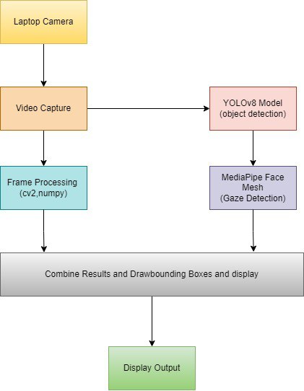
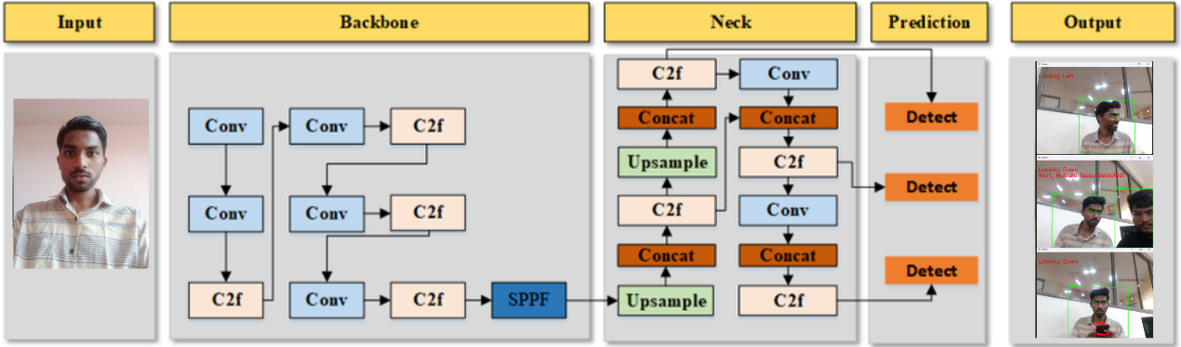
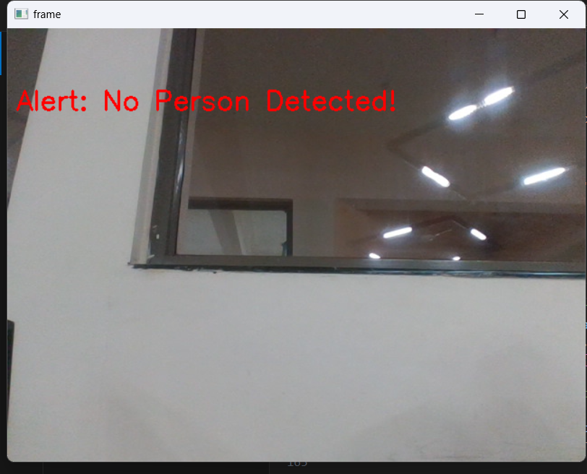
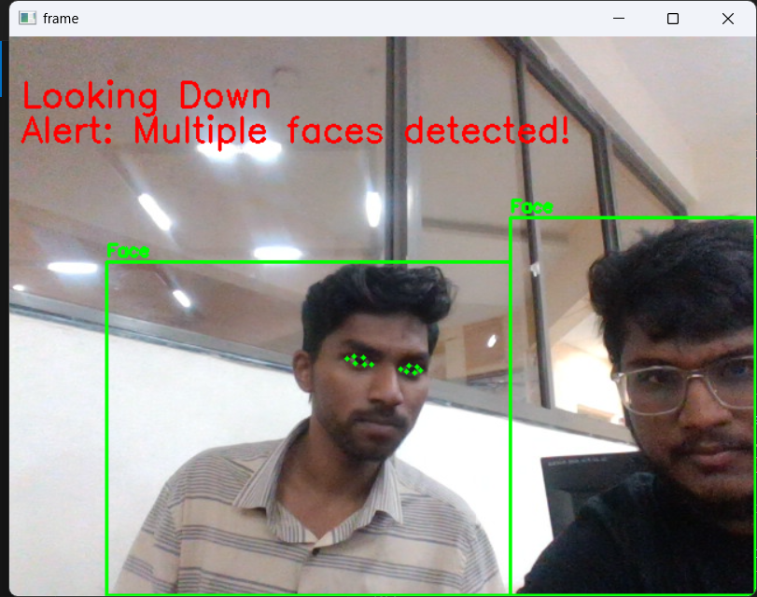
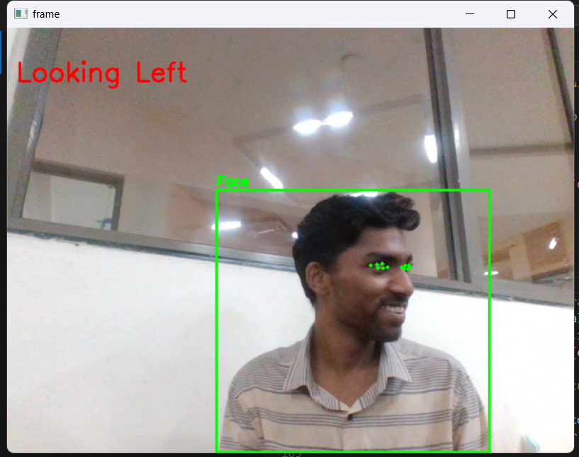
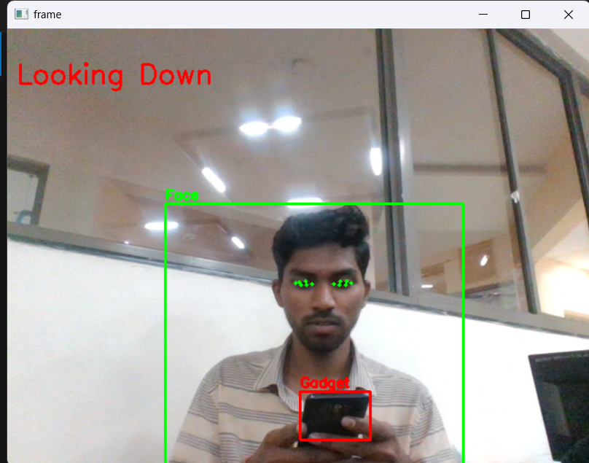
Cheat Detection in Online Examinations
Nitin Nagaral , Pratham Shirol , Devaraj Hireraddi , Girish Dongrekar , Kushalagouda Patill
Guide Name : Prof. Guruprasad. S. K
Minor Project -2
23ECSW304
TM
Architecture
Proposed work / Algorithm
Domain : AIML
Problem Statement : Designing a online exam cheat detection model, that is used for monitoring, identity verification, gadget detection and eye movement tracking
YOLOv8 for Gadget Detection
MediaPipe Face Mesh for Facial Landmark Analysis
Real-Time Processing
Additional Features
Objectives
Develop a robust real-time surveillance solution for monitoring examination environments.
Utilize YOLOv8 for detecting unauthorized gadgets.
Employ MediaPipe Face Mesh for analyzing facial landmarks to monitor gaze direction and patterns.
Ensure the system can detect and analyze various aspects of the examinee's behavior and surroundings efficiently​
Results & Discussions
Methodology
System Design and Setup: Set up high-resolution cameras, computing resources, and install necessary libraries.
Data Collection and Preparation: Collect and annotate images/videos of unauthorized gadgets and facial expressions.
Model Training: Train YOLOv8 for gadget detection and fine-tune MediaPipe Face Mesh for facial landmark and gaze tracking.
System Integration: Integrate YOLOv8 and MediaPipe Face Mesh for real-time monitoring and develop an alert system for unauthorized gadgets and suspicious eye movements.
Conclusion
The developed system enhances automated exam monitoring using YOLOv8 for
detecting unauthorized devices and MediaPipe Face Mesh for real-time facial surveillance. YOLOv8 ensures immediate detection of gadgets like phones and
laptops, while MediaPipe tracks eye movements and blinks, alerting proctors to suspicious behavior. This system sets the stage for advanced, intelligent exam
security and efficiency.
The online exam cheat detection model effectively utilized YOLOv8 for detecting unauthorized gadgets with high accuracy and MediaPipe Face Mesh for reliable blink detection and gaze estimation.

